Slide 1
Usability Testing

Slide 2
What is Usability?
Usability Is a measure of how easy it is to use something:
How easy will the use of the software be for a typical user to understand, learn, and operate
e.g., “user-friendliness”
Usability is difficult to evaluate and measure

Slide 3
ISO Definition (9241-11) for Usability:
“...the extent to which a product can be used by specified users to achieve specified goals with effectiveness, efficiency and satisfaction in a specified context of use.”

Slide 4
What is Usability Testing?
Usability Testing is an attempt to quantify software user-friendliness according to:
Skill needed to learn the software
Time required to become efficient in using the software
The measured increase in user productivity
A subjective assessment of a user’s attitude toward using the software

Slide 5

What is Usability Testing?
The idea is to place users in front of some version of the software under test and watch how these users try to use it
Can be expensive depending on what tasks you have users try and on what you are watching for
Not cost-effective if done too late in dev cycle
Can uncover usability problems that design guidelines and inspections may have missed

Slide 6
Countering criticisms
Why bother usability testing if we don't have time, money, or expertise to do very much of it?
Why can't the developers just test the product by using it themselves and seeing what does / doesn't work for them?
developer knows product too well; can't see it like a newbie
even limited testing is better than none
few early tests are better than many late tests
ideally, usability testing is iterative; done over and over

Slide 7
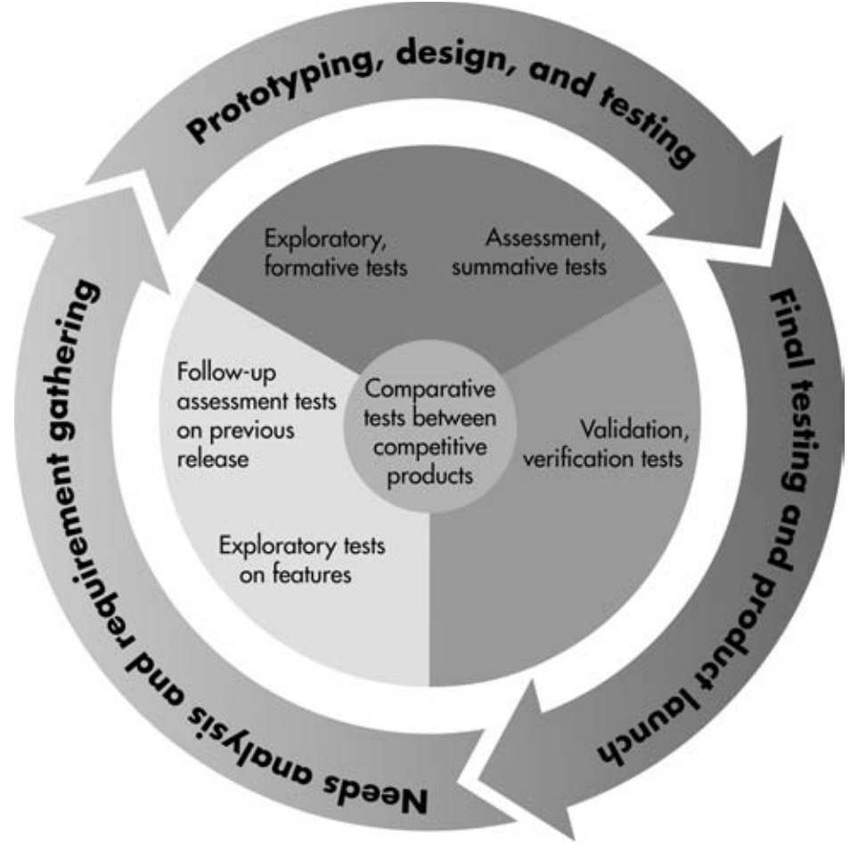
When to usability test?
When should a usability test be performed?
best done early in the software lifecycle
best done often / repeatedly
type of test may vary depending on how far along the process you are
early: paper prototype
middle: compare UI designs
later: verify UI's usability
can keep a historical record of usability results for each test

Slide 8
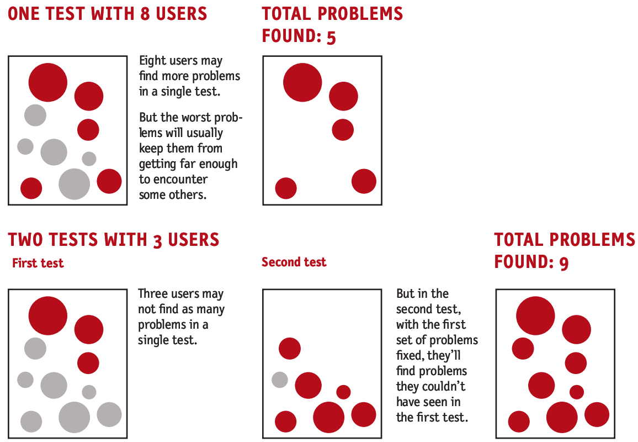
Benefits of multiple tests

Slide 9
Formal vs. Informal Testing
Formal testing might entail building a usability testing lab, equipping it with an array of computers, audio-video equipment, then staffing it with psychologists, technicians, and human-computer interaction specialists
Informal approach: No fancy lab or expensive equipment
A simple test plan and task list are prepared, notepad and pencil
Participants are observed by an impartial moderator
The advantage is that informal testing looks at what people actually do when they are doing real work in an ordinary setting

Slide 10
Testing Basics: 5-Step Process

Slide 11
Step 1: Plan & Prepare
Create a Task List:
Create lists of tasks or questions that a typical user should be able to complete in an hour
Tasks should not be too simple nor too difficult to accomplish
e.g., 1. Find a concert show you want to see
2. Purchase tickets on line
3. Find directions to the venue

Slide 12
Step 1: Plan & Prepare
Informal usability tests only require a pencil, paper, computer and browser
Sometimes might use a video camera and record each session
Sometimes watched by development team
Often usability tests can be conducted within the user’s own environment
Keep a printed version of the site for note taking, and then watch and learn . . .

Slide 13
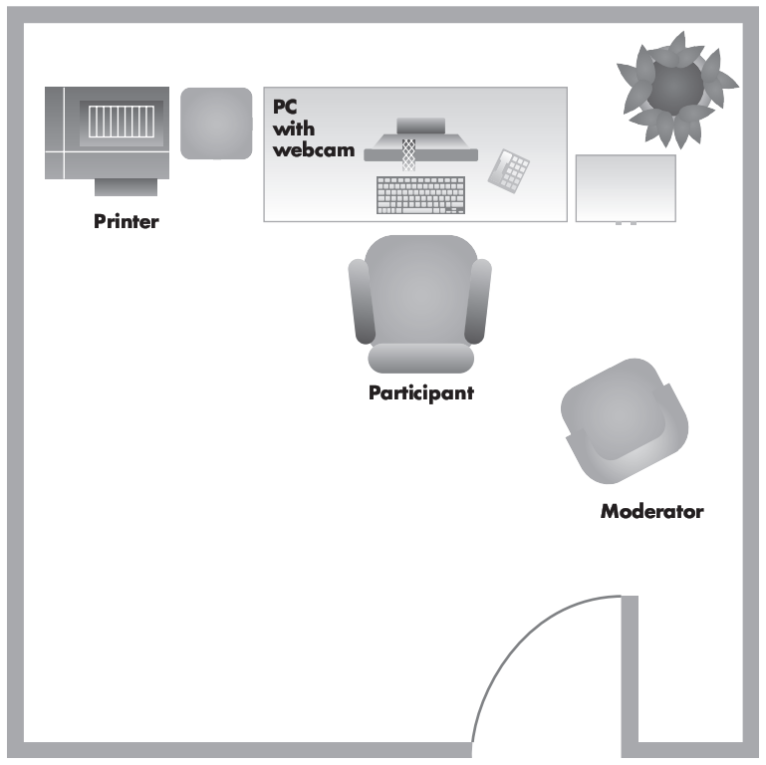

Usability study room setup
preferred: a quiet room with a computer and 2-3 chairs
participant sits at computer and performs tasks w/ product
moderator / facilitator guides the user through the process
others on dev team observe user, either from the side or from another room (preferred)
web cam, one-way mirror, etc.
record the user and watch later

Slide 14

Step 2: Find Participants
Can I make my mother test our app? Does it matter who the users are for a usability test?
An ideal test has at least 3-4 users who have not been told much about the app beforehand.
It doesn't matter much who you grab as your user; doesn't have to be just like a real user of the app.
Everyone's a beginner in a way.
It's bad to design a site that only experts can use.
Experts don't mind something simple enough for beginners, so testing with beginners is not bad.
UNLESS the app requires specific expert knowledge to use.

Slide 15

Step 3: Conduct the Session
Who is qualified to be a study facilitator? What things should / shouldn't a facilitator do?
Anybody with decent people skills can do it.
Be friendly.
Tell them it's okay to make mistakes; they aren't being tested.
Encourage them ask questions and to think out loud.
Don't lead the user or give them hints about what to do.
Probe; when they give feedback, ask for more details.
Don't appear to be concerned with note-taking or data gathering.
Don't be upset if the user fails or gets stuck.
Ask user questions when they get stuck.
"What are you thinking?" or "What are you trying to do now?"
Tip: Try taking the test yourself first.

Slide 16
Step 3: Conduct the Session
Collect basic data:
Could the user complete the task?
Did they need help?
Track how much time it took them
Note any stumbling blocks (problems/obstacles)
Overall observations, commentary
Debrief the user, allow user to speak their mind
Prepare a post-test survey

Slide 17
Step 3: Conduct the Session
Post-Test Survey:
Prepare a survey online or in paper form for the user to fill out after they have completed the testing process
Questions should include what the user thought the Web site was like: graphics, logic, content, navigation, and their overall satisfaction
Gather data about overall effectiveness of the site in relation to the goals of each task

Slide 18
Step 4: Analyze Results
Compile and summarize data
Transfer handwritten notes to computer
Write your reports while they are fresh in your mind,
Create a summary after testing is complete, into a table that shows the results of each test, include problem areas, comments and user feedback from the survey

Slide 19
Step 4: Analyze Results
Identify difficulties and problem areas
Identify why there was difficulty or the source of any problems (specific factors such as navigation, text, graphics, etc.)
Identify any specific task-oriented issues

Slide 20
Step 5: Make Recommendations
Compile and recommend
Gather all your compiled information and translate into recommendations
Concentrate on high-level functionality first
Then focus on recommendations for improved user experience (what works and what does not work well for users!)
Determine the implementation plan
Write up a formal report

Slide 21
Usability Study: UCSC NetTrial
NetTrial was a trial online literacy course used to help students learn how to develop Web skills (browsing, e-mail, use of library resources)
Students were not given specific tasks, rather they were asked to navigate the entire site as if they were taking the course, then to provide feedback

Slide 22
Usability Study: UCSC NetTrial
During the usability testing, it was observed that the students had difficulty finding graphic links, navigating to other pages and returning to previous pages, and difficulty understanding
After the study was completed, the observation notes and student feedback notes were used to identify problem areas that needed changing
The final version of the Web site was a success, and the usability testing played a critical role

Slide 23
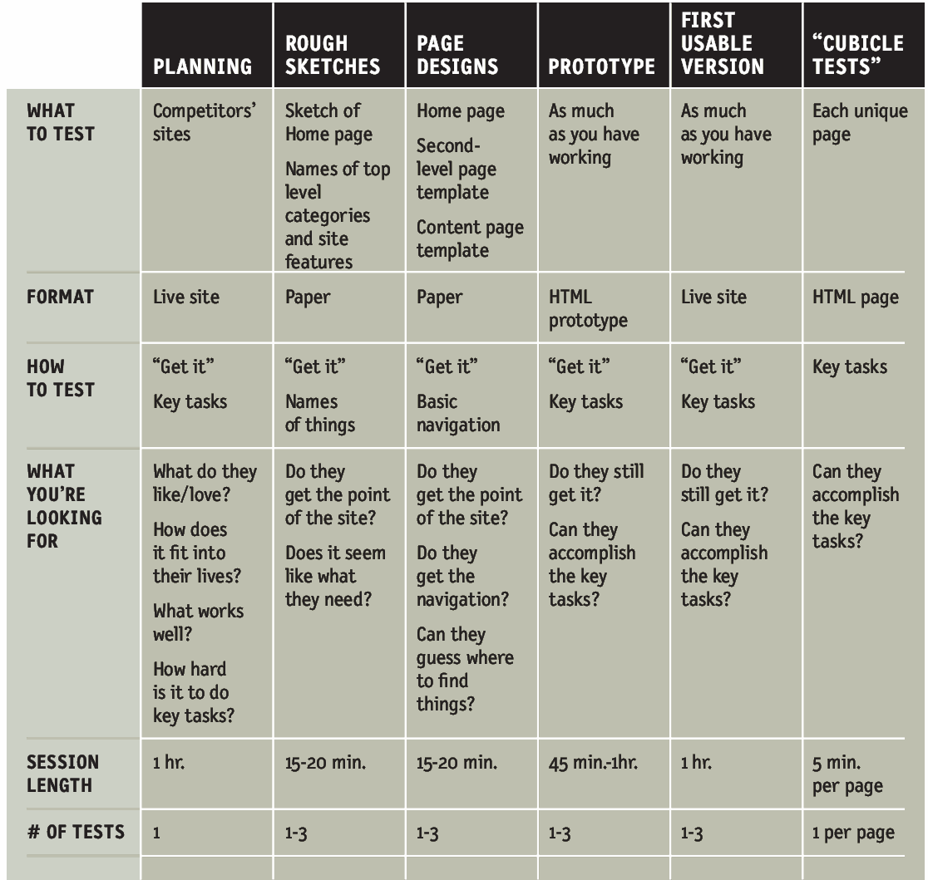
Usability
Test plan

Slide 24
Re-Cap
In general, Usability is difficult to evaluate and measure (Web sites may be the exception)
Usability testing can be done on a formal or informal basis
The method described here is an informal 5-step process
Sometimes video taped
Sometimes watched by development team
Know your goal: testing to find problem areas in your software!
Results show what works, what does not

Slide 25
Assessment 3 Guideline
What to submit with the Testing plan
Browser testing with the screenshot
Responsiveness with the screenshot
Functional testing – Screenshot of all pages

